Slide 1
10、图像语义分割 Semantic Segmentation
罗志明
zhiming.luo@xmu.edu.cn

Slide 2
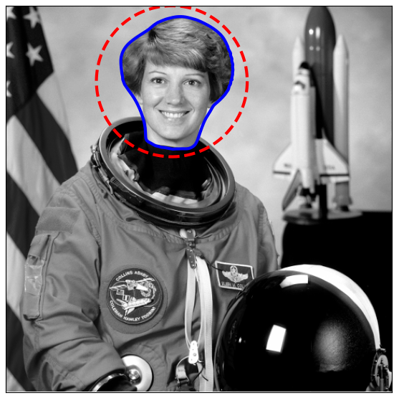
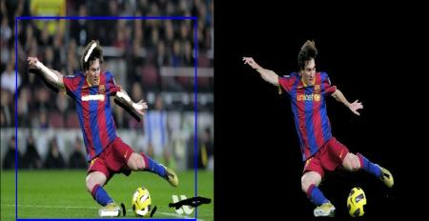
图像与物体分割（Image and object segmentation）
图像分割
提取物体的轮廓、识别目标前景区域

Slide 3
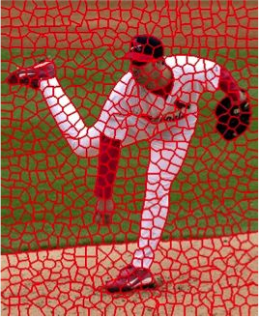
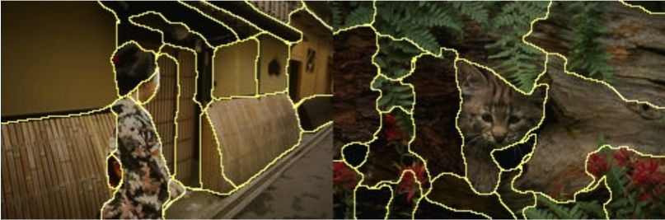
图像与物体分割
图像分割
将具有相似性质的像素组合成小的区域 (Regions)
超像素 (Superpixels)

Slide 4
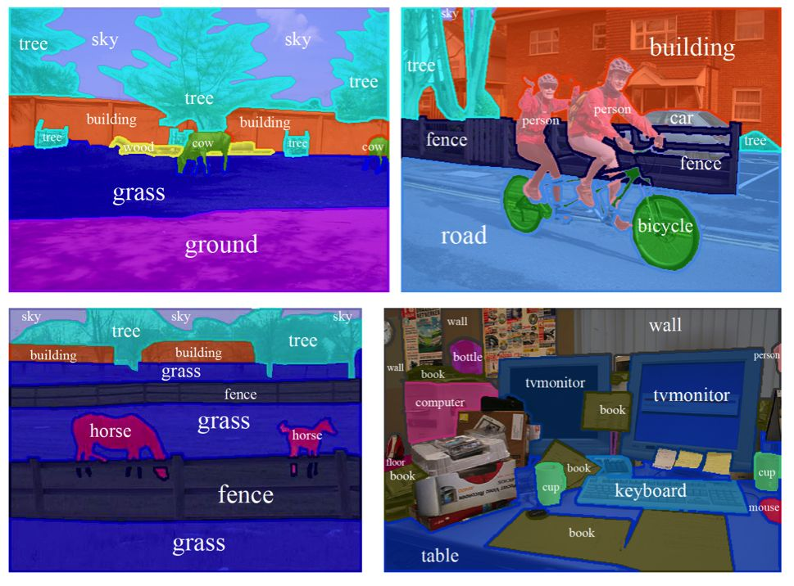
图像与物体分割
将图像识别对应的语义目标类别
目标层次分割：需要对目标进行准备的定位与识别

Slide 5
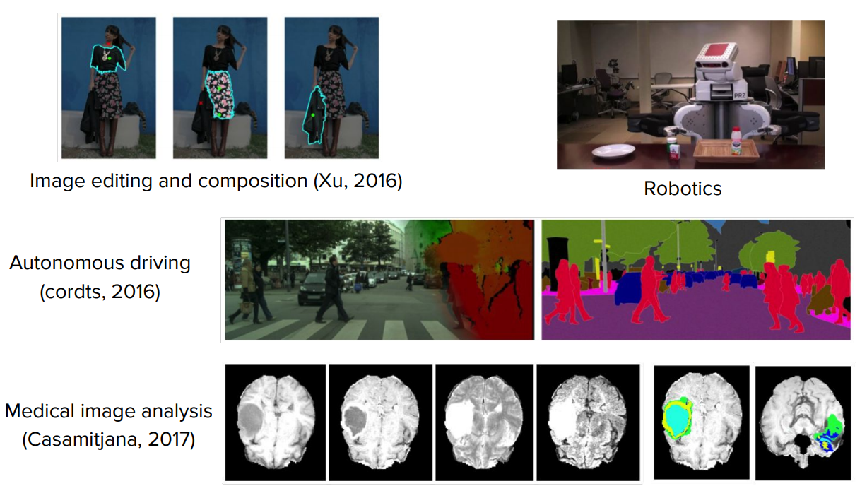
相关应用

Slide 6
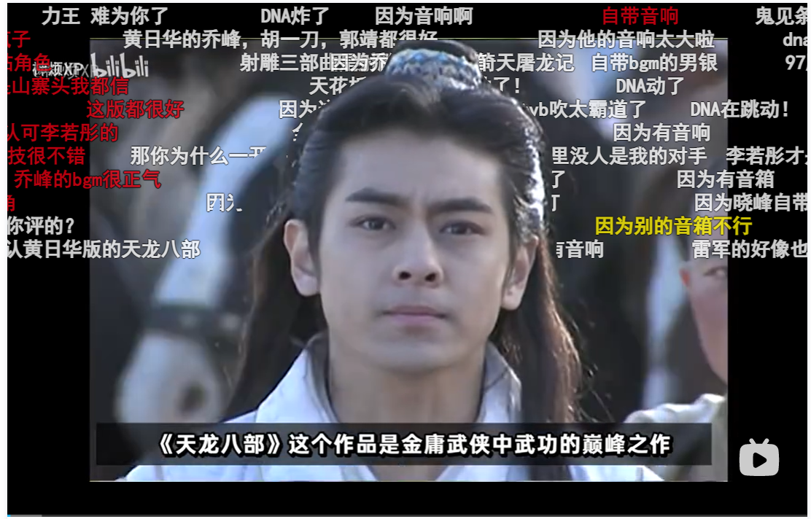
相关应用

Slide 7
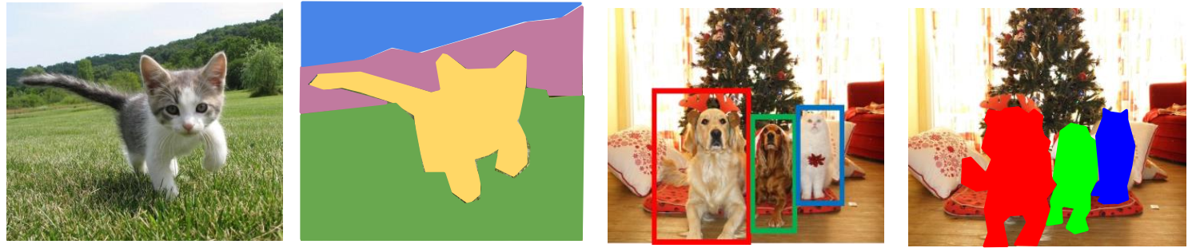
视觉识别任务
图像分类
语义分割
目标检测
实例分割

Slide 8
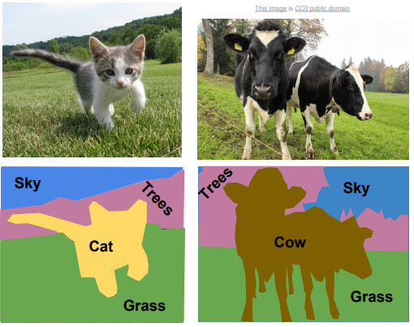
语义分割 (Semantic Segmentation)
识别每一个像素的语义类别
并不区分不同的实例

Slide 9
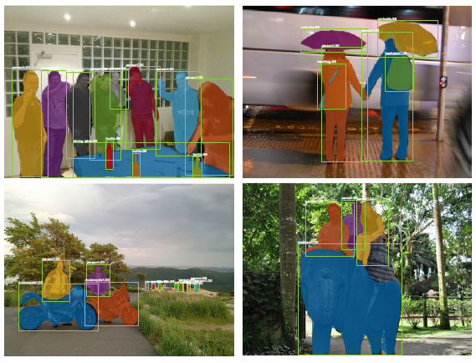
实例分割 (Instance Segmentation)
检测目标实例、分类，并识别对应的前景像素
语义标签：语义类别、实例ID
不识别背景类

Slide 10
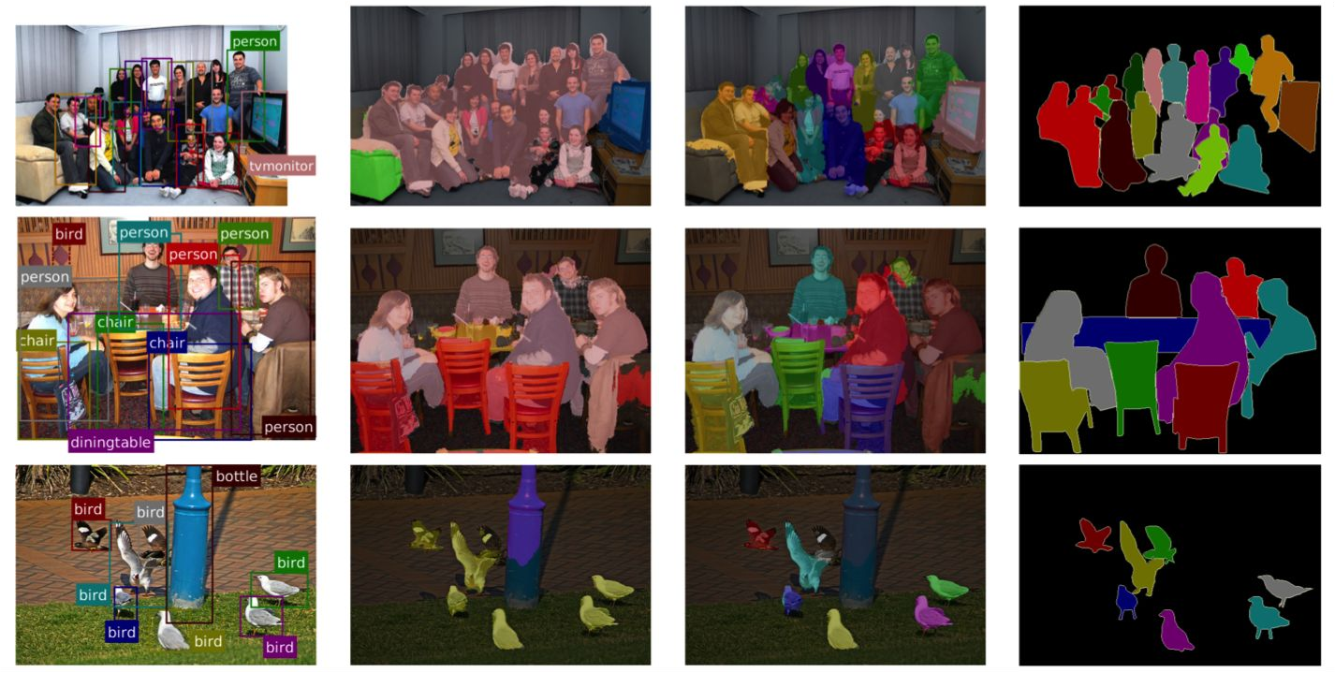
Semantic vs Instance Segmentation
Object Detection
Semantic Segmentation
Instance Segmentation
Ground truth

Slide 11
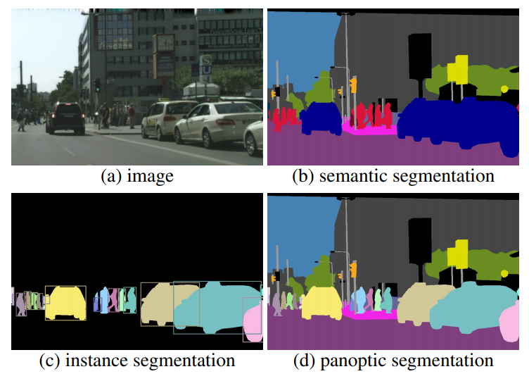
全局分割 (Panoptic Segmentation)
语义分割与实例分割的融合
Stuff 、Thing类别
Stuff: sky, road, …
Thing: pedestrian, vehicle, …
Kirillov, et al. Panoptic Segmentation, CVPR 2019

Slide 12
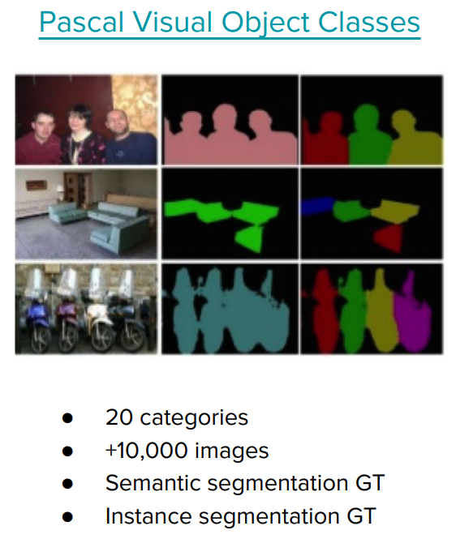
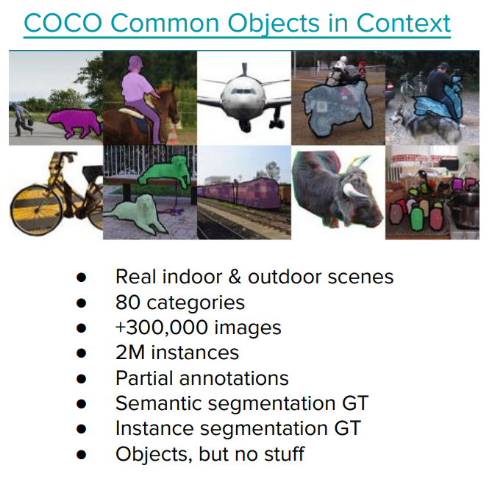
Datasets

Slide 13
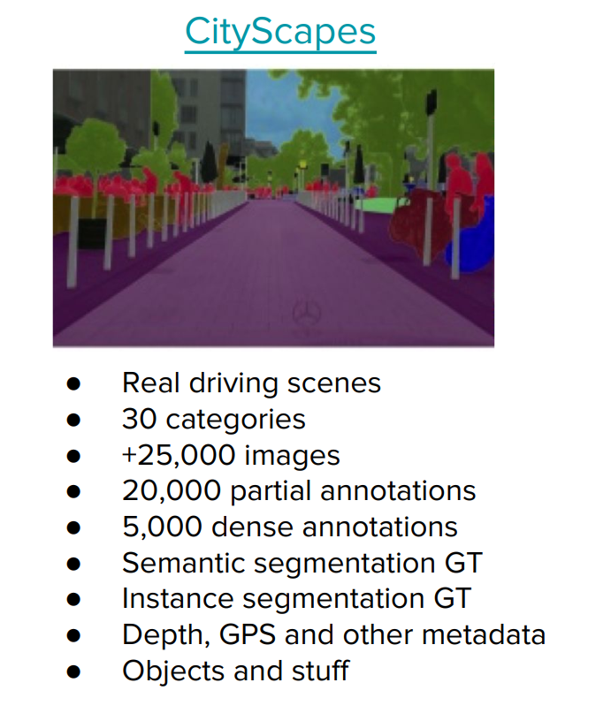
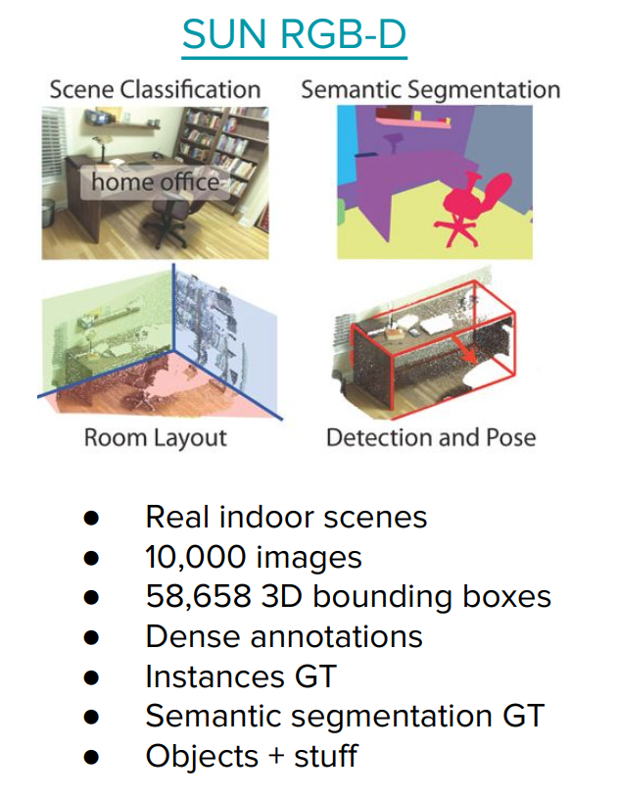
Datasets

Slide 14
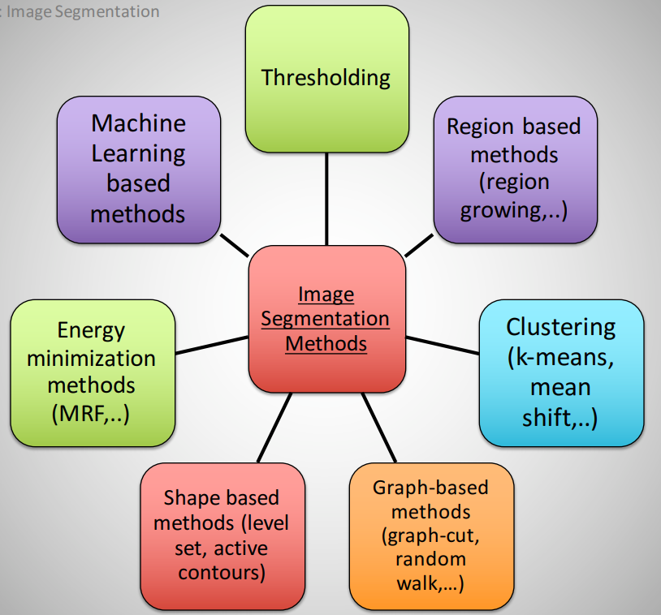
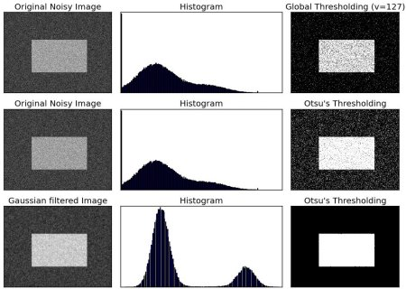
图像分割的方法

Slide 15
语义分割
评价指标
损失函数
代表性模型

Slide 16
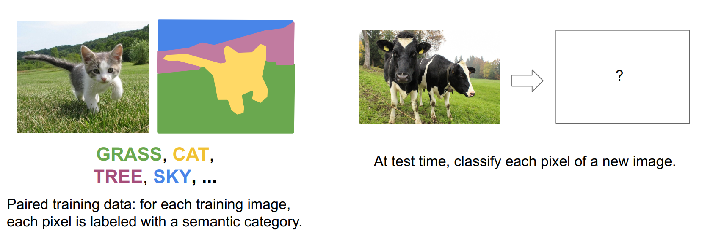
语义分割：问题定义

Slide 17
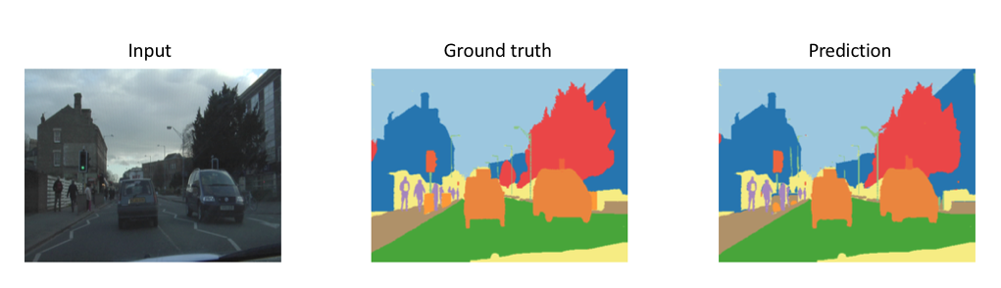
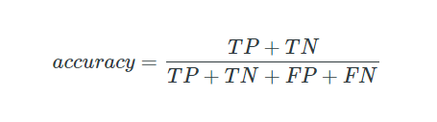
语义分割：评价指标
Pixel Accuracy
Mean Pixel Accuracy
…

Slide 18
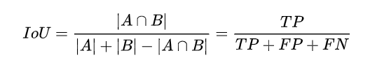
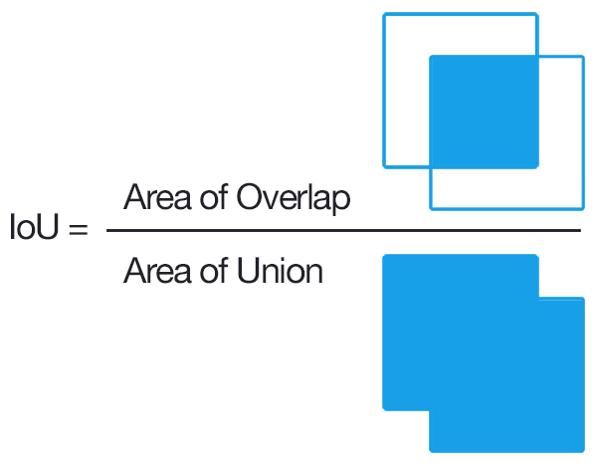
语义分割：评价指标
Intersection-over-Union (IoU)
mIoU
…

Slide 19
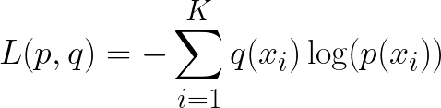
语义分割：损失函数
语义分割可以看成是对每一个像素进行单独分类的任务
交叉熵损失函数（Cross-Entropy Loss）

Slide 20
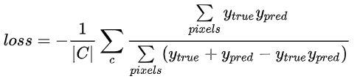
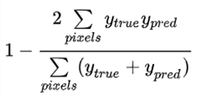
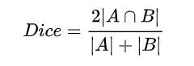
语义分割：损失函数
IoU相关的损失函数
Soft IoU Loss：
Dice Loss

Slide 21
语义分割：代表性模型
FCN
Learnable Upsampling
DeepLab
Dilated Convolution
U-Net
PSPNet

Slide 22
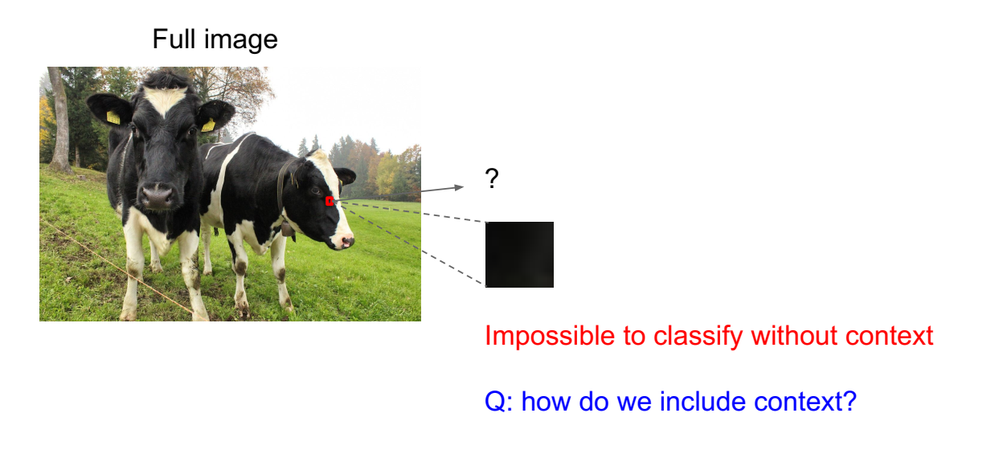
From classification to semantic segmentation

Slide 23
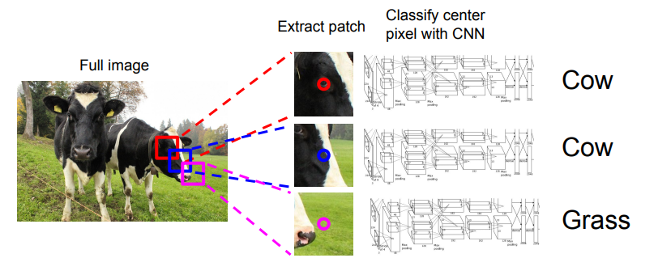
From classification to semantic segmentation
Low efficiency: a large amount of repeated computation
between overlapping patches.

Slide 24
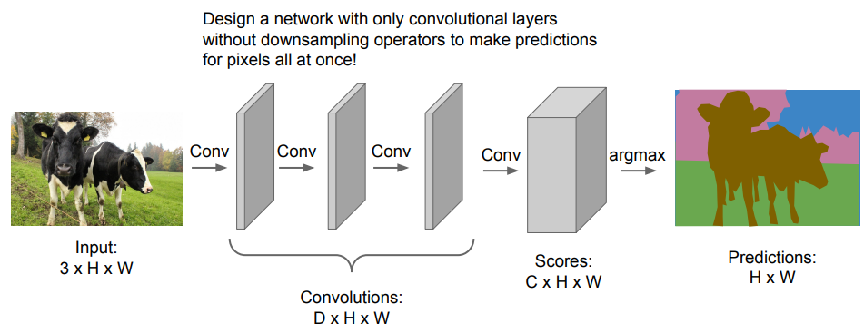
From classification to semantic segmentation
Fully convolutional neural networks
Limited receptive field: each pixel only can use information inside a small patch;
requires a large amount of GPU memory.

Slide 25
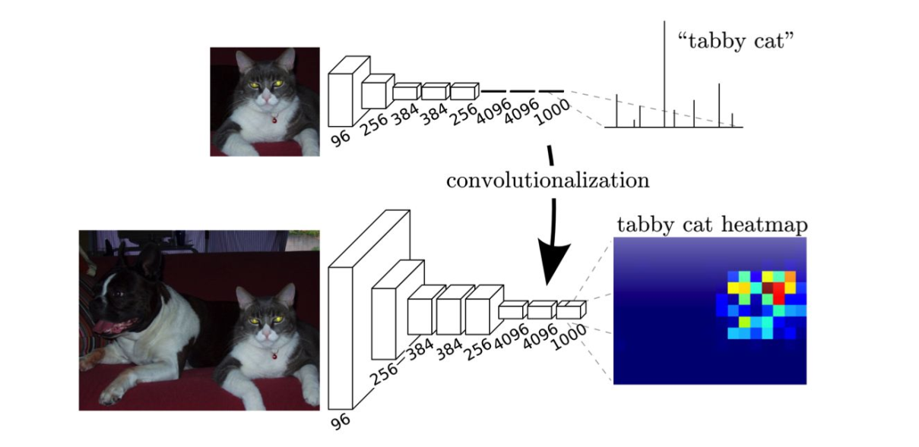
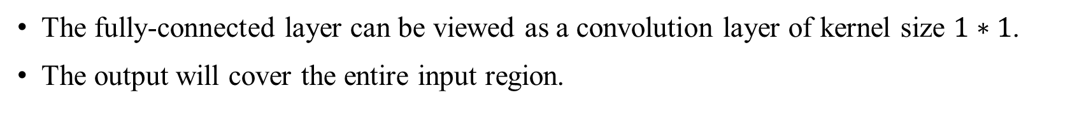
From classification to semantic segmentation
The fully-connected layer can be viewed as a convolution layer of kernel size $1∗1$.
The output will cover the entire input region.
Long, et al. Fully Convolutional Networks for Semantic Segmentation, CVPR 2015

Slide 26
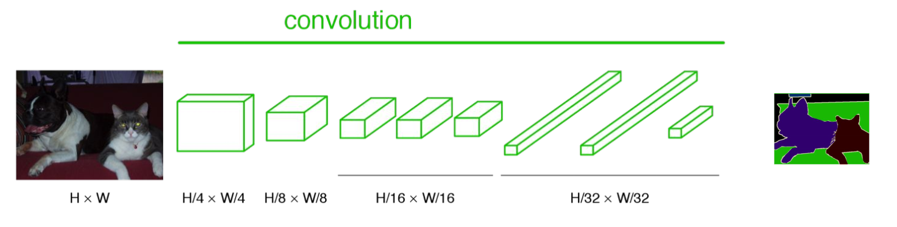
From classification to semantic segmentation
Dense Prediction: fully convolutional, end-to-end, pixel-to-pixel network
Pixelwise cross-entropy loss function for training.
Problems
Output is small than the input → Add upsampling layers
Output is very coarse → Add fine details from previous layers

Slide 27
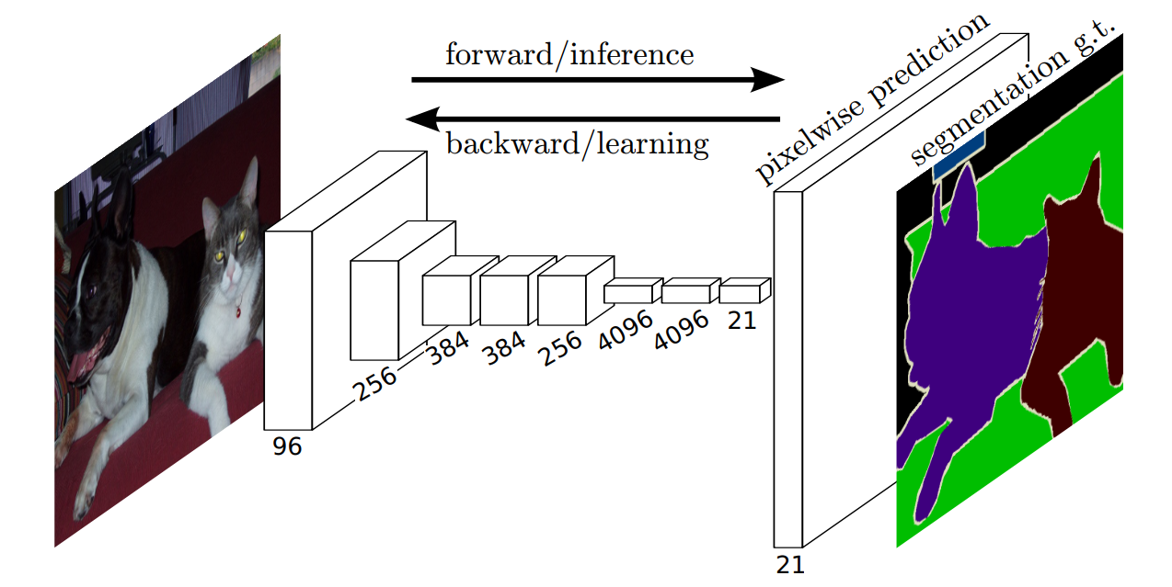
From classification to semantic segmentation
Dense Prediction: fully convolutional, end-to-end, pixel-to-pixel network
Learnable Upsampling (Deconvolution)
Pixelwise cross-entropy loss function for training.

Slide 28
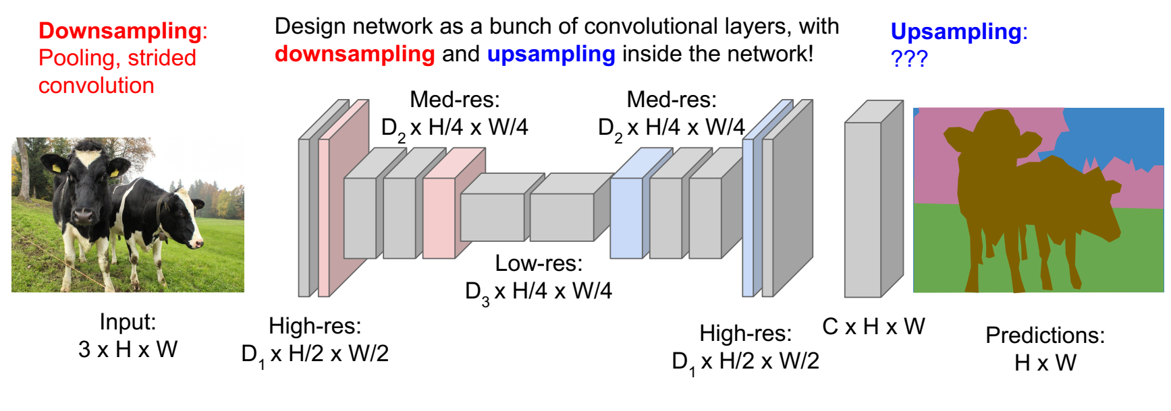
From classification to semantic segmentation

Slide 29
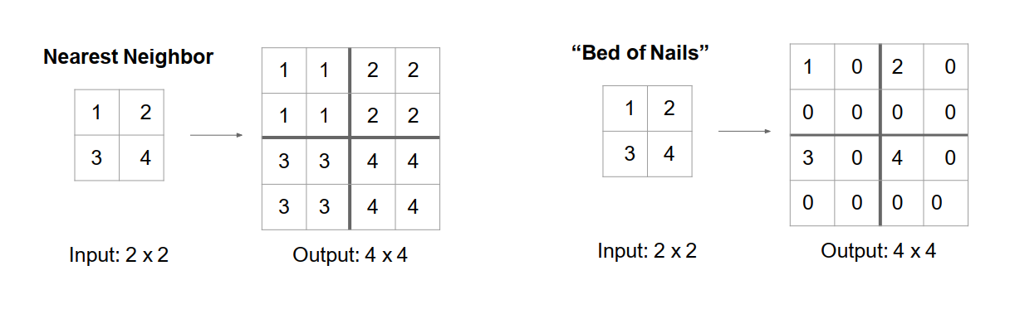
Upsampling -- UnPooling

Slide 30
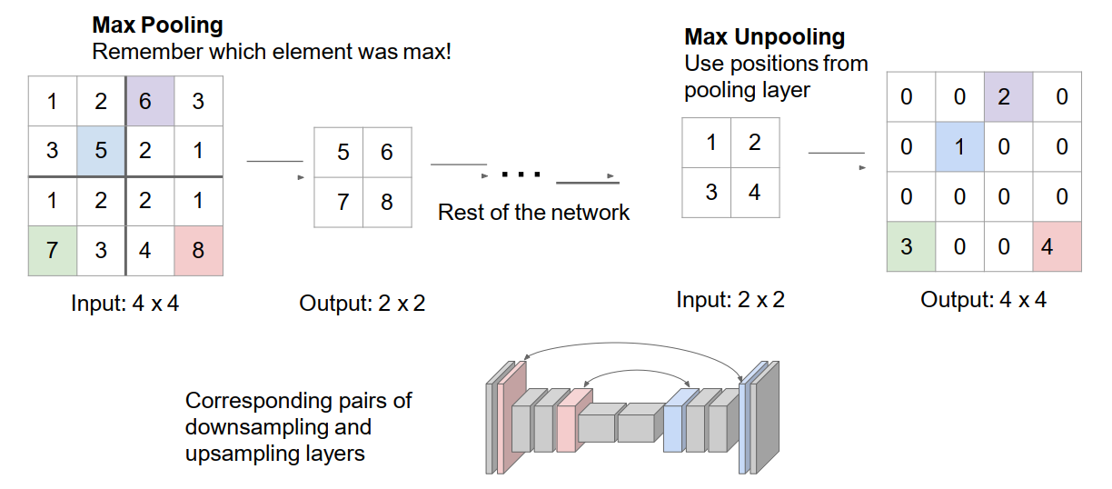
Upsampling – Max UnPooling

Slide 31
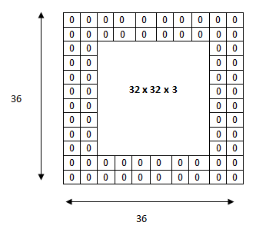
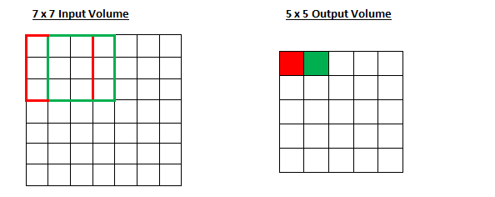

Learnable upsampling: convolution layer
K=3, S=1

Slide 32
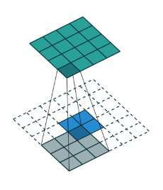
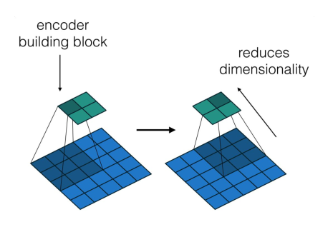
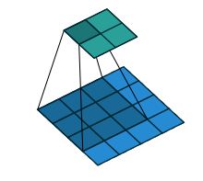
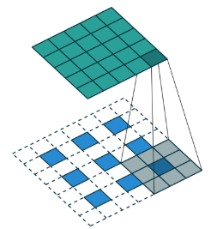
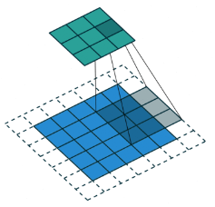
Learnable upsampling: recovering spatial shape
Vincent Dumoulin, Francesco Visin, “A guide to convolution arithmetic for deep learning”

Slide 33
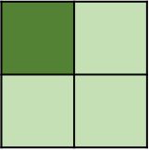

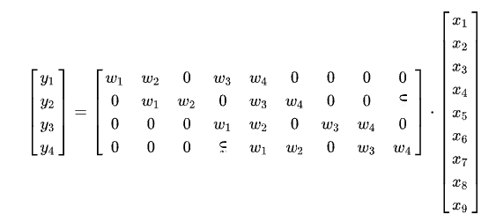

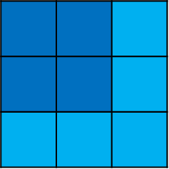

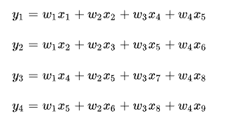

Convolution as Matrix Multiplication
$$y=Cx$$
https://zhuanlan.zhihu.com/p/355089493

Slide 34
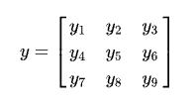

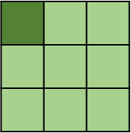




Deconvolution (Transposed Convolution)
$$y=C^{T}x$$

Slide 35


Resolution: spectrum of deep features
Problem: coarse output
Combine shallow features with the deep features

Slide 36

Fine details: skip connections
skip connection
fuse layers
End-to-end training

Slide 37





Experimental Results

Slide 38


Transposed Convolution in PyTorch
https://pytorch.org/docs/stable/generated/torch.nn.ConvTranspose2d.html

Slide 39

Transfer Learning
Cast ImageNet models (AlexNet, VGG, GoogLeNet, etc.) into FCNs and augment them for segmentation:
Discard classifier layer,
Transform FC to CONV,
Upsampling
Add skip connections
Add $1×1$ CONV with $K$ filters for prediction at each output location,
Train for segmentation by fine-tuning all layers with PASCAL VOC 2011 with a pixelwise loss (e.g., Cross-Entropy).

Slide 40

FCN Code
https://github.com/wkentaro/pytorch-fcn

Slide 41



Deconvolution and Checkerboard Artifacts
Bilinear Interpolation + Convolution
https://distill.pub/2016/deconv-checkerboard/

Slide 42

Deconvolution Network

Slide 43

DeepLab
Atrous Convolution
Spatial Pyramid
CRF (post-processing)

Slide 44


Atrous (Dilated) Convolution

Slide 45



Conditional Random Field (CRF)
https://slidetodoc.com/markov-random-fields-and-segmentation-with-graph-cuts/

Slide 46




Conditional Random Field (CRF)

Slide 47



Conditional Random Field (CRF)
Energy Function

Slide 48

DeepLab Results

Slide 49


DeepLab Results

Slide 50

U-Net
A contracting path and an expansive path
Adds convolutions in the upsampling path
Skip connections: concatenation of feature maps
Ronneberger et al. U-Net: Convolutional Networks for Biomedical Image Segmentation, MICCAI 2015.

Slide 51
U-Net
“Contraction” Phase
- Increases field of view
- Lose Spatial Information

Slide 52
U-Net
“Expansion” Phase
Create High Resolution
Mapping

Slide 53
U-Net
Concatenate with high-resolution feature maps from the Contraction Phase

Slide 54


U-Net

Slide 55


PSPNet
Different sub-region representation
Local and global context information
Deep Supervision
Auxiliary Supervision
Zhao, et al. Pyramid Scene Parsing Network, CVPR 2017

Slide 56


PSPNet
Zhao, et al. Pyramid Scene Parsing Network, CVPR 2017

Slide 57
Resources
https://www.slideshare.net/xavigiro/image-segmentation-with-deep-learning-xavier-giro-carles-ventura-issondl-2020?next_slideshow=1
http://cs231n.stanford.edu/slides/2020/lecture_12.pdf
https://www.jeremyjordan.me/evaluating-image-segmentation-models/
https://github.com/qubvel/segmentation_models.pytorch
https://github.com/MIC-DKFZ/nnUNet
https://amaarora.github.io/2020/09/13/unet.html

